Slide 1
Verilog

Slide 2
Behavioral Description
initial:
is executed once at the beginning.
always:
is repeated until the end of simulation.

Slide 3
Clock Generation
Two methods:
15 cycles of clock.
clock period = 20 time units.
initial
begin
clock = 1’b0;
repeat (30)
#10 clock = ~clock;
end
initial
begin
clock = 1’b0;
#300 $finish;
end
always
#10 clock = ~clock;

Slide 4
? Description
Output Q must be declared as reg.
Inside initial and always, if-else and case statements can be used.
//HDL Example 5-1
//--------------------------------------
//Description of xxxx (See Fig.5-6)
module xxxx (Q,D,control);
output Q;
input D,control;
reg Q;
always @ (control or D)
if (control == 1) Q = D; //Same as: if (control)
endmodule

Slide 5
D-Latch Description
Output Q must be declared as reg.
Inside initial and always, if-else and case statements can be used.
//HDL Example 5-1
//--------------------------------------
//Description of D latch (See Fig.5-6)
module D_latch (Q,D,control);
output Q;
input D,control;
reg Q;
always @ (control or D)
if (control == 1) Q = D; //Same as: if (control)
endmodule

Slide 6
D Flip-Flop Description
//HDL Example 5-2
//---------------------------
//D flip-flop
module D_FF (Q,D,CLK);
output Q;
input D,CLK;
reg Q;
always @ (posedge CLK)
Q = D;
endmodule

Slide 7
D Flip-Flop Description
//HDL Example 5-2
//---------------------------
//D flip-flop
module D_FF (Q,D,CLK);
output Q;
input D,CLK;
reg Q;
always @ (posedge CLK)
Q = D;
endmodule
//D flip-flop with asynchronous reset.
module DFF (Q,D,CLK,RST);
output Q;
input D,CLK,RST;
reg Q;
always @(posedge CLK or negedge RST)
if (RST == 0) Q = 1'b0; // Same as: if (~RST)
else Q = D;
endmodule

Slide 8
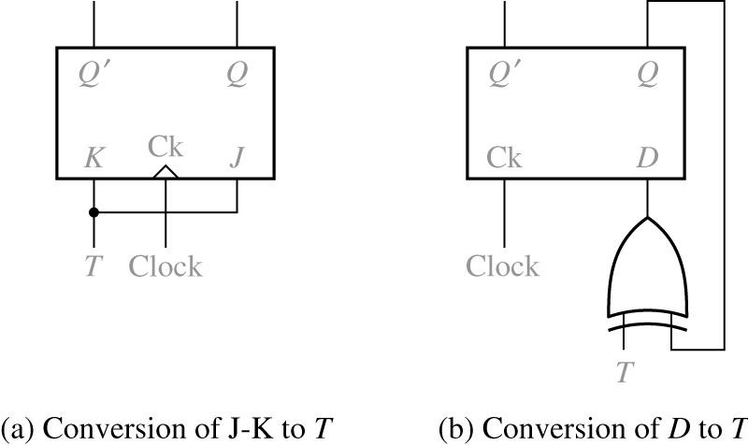
T-FF Description (Structural)
//HDL Example 5-3
//----------------------------------------
//T flip-flop from D flip-flop and gates
module TFF (Q,T,CLK,RST);
output Q;
input T,CLK,RST;
wire DT;
assign DT = Q ^ T ;
//Instantiate the D flip-flop
DFF TF1 (Q,DT,CLK,RST);
endmodule

Slide 9
JK-FF Description (Structural)
//JK flip-flop from D flip-flop and gates
module JKFF (Q,J,K,CLK,RST);
output Q;
input J,K,CLK,RST;
wire JK;
assign JK = (J & ~Q) | (~K & Q);
//Instantiate D flipflop
DFF JK1 (Q,JK,CLK,RST);
endmodule

Slide 10
JK-FF Description (Behavioral)
case executes one of the statements.
//HDL Example 5-4
//----------------------------------
// Functional description of JK flip-flop
module JK_FF (J,K,CLK,Q,Qnot);
output Q,Qnot;
input J,K,CLK;
reg Q;
assign Qnot = ~ Q ;
always @ (posedge CLK)
case ({J,K})
2'b00: Q = Q;
2'b01: Q = 1'b0;
2'b10: Q = 1'b1;
2'b11: Q = ~ Q;
endcase
endmodule

Slide 11
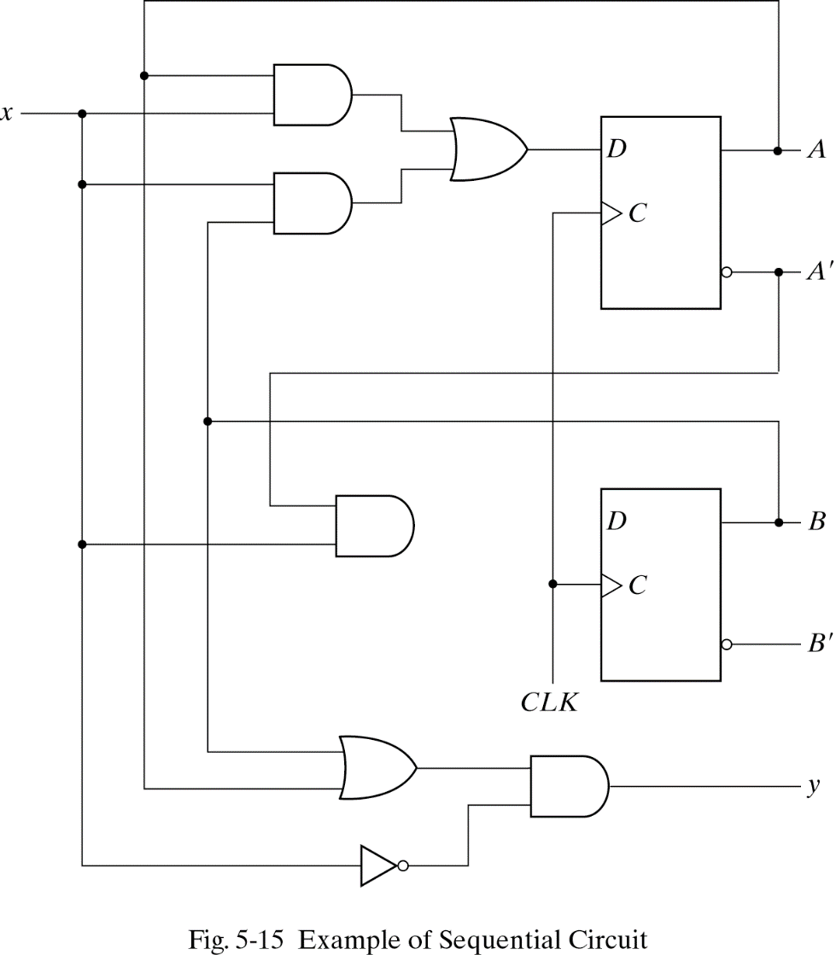
A Sequential Circuit: Schematic Diagram

Slide 12
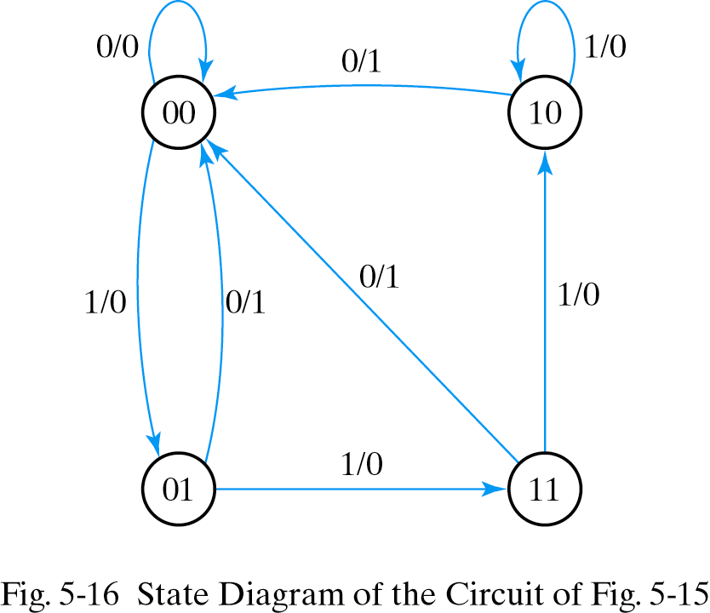
State Diagram (Behavioral)

Slide 13
Mealy (Behavioral)
module Mealy_mdl (x,y,CLK,RST);
input x,CLK,RST;
output y;
reg y;
reg [1:0] Prstate, Nxtstate;
parameter S0 = 2'b00, S1 = 2'b01, S2 = 2'b10, S3 = 2'b11;
always @ (posedge CLK or negedge RST)
if (~RST) Prstate = S0; //Initialize to state S0
else Prstate = Nxtstate; //Clock operations
always @ (Prstate or x) //Determine next state
case (Prstate)
S0: if (x) Nxtstate = S1;
else Nxtstate = S0;
S1: if (x) Nxtstate = S3;
else Nxtstate = S0;
S2: if (~x)Nxtstate = S0;
else Nxtstate = S2;
S3: if (x) Nxtstate = S2;
else Nxtstate = S0;
endcase
always @ (Prstate or x) //Evaluate output
case (Prstate)
S0: y = 0;
S1: if (x) y = 1'b0; else y = 1'b1;
S2: if (x) y = 1'b0; else y = 1'b1;
S3: if (x) y = 1'b0; else y = 1'b1;
endcase
endmodule
parameter defines constants.

Slide 14
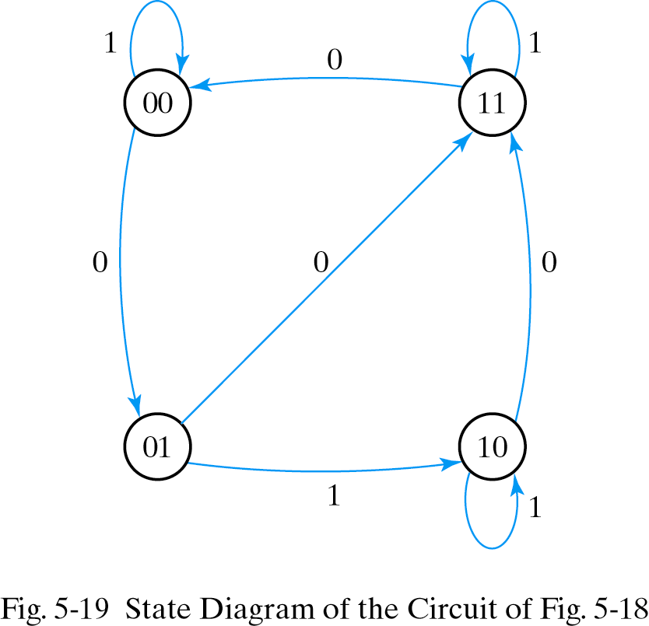
Moore (Behavioral) (One always)
module Moore_mdl (x,AB,CLK,RST);
input x,CLK,RST;
output [1:0]AB;
reg [1:0] state;
parameter S0 = 2'b00, S1 = 2'b01, S2 = 2'b10, S3 = 2'b11;
always @ (posedge CLK or negedge RST)
if (~RST) state = S0; //Initialize to state S0
else
case (state)
S0: if (~x) state = S1; else state = S0;
S1: if (x) state = S2; else state = S3;
S2: if (~x) state = S3; else state = S2;
S3: if (~x) state = S0; else state = S3;
endcase
assign AB = state; //Output of flip-flops
endmodule

Slide 15
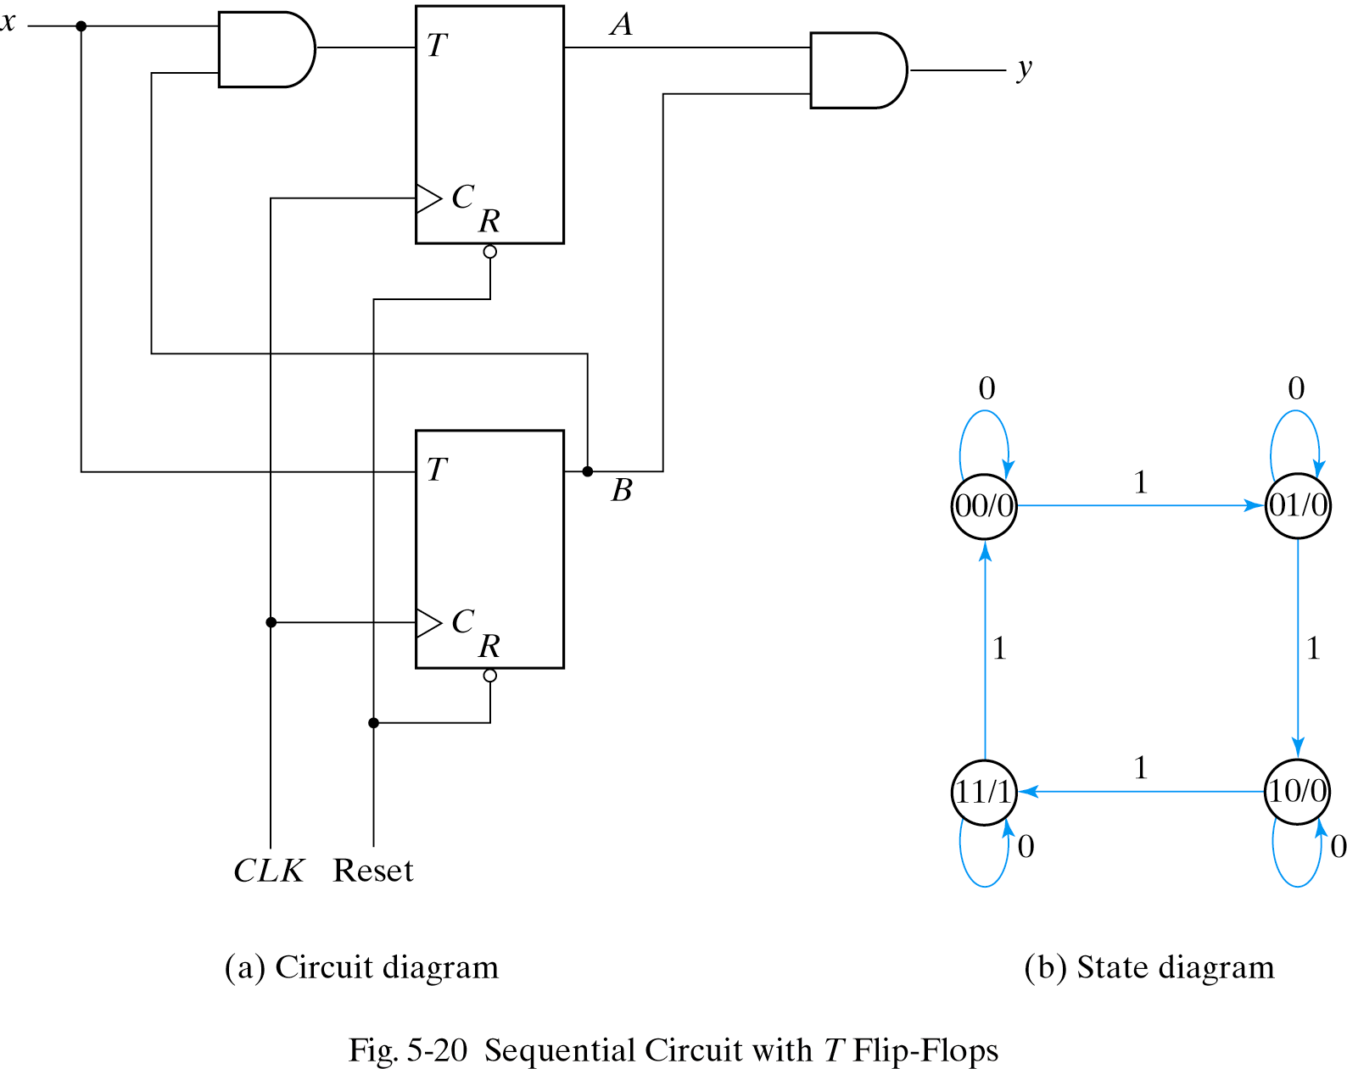
Moore (Structural)

Slide 16
Moore (Structural)
module Tcircuit (x,y,A,B,CLK,RST);
input x,CLK,RST;
output y,A,B;
wire TA,TB;
//Flip-flip input equations
assign TB = x,
TA = x & B;
//Output equation
assign y = A & B;
//Instantiate T flip-flops
T_FF BF (B,TB,CLK,RST);
T_FF AF (A,TA,CLK,RST);
endmodule
//T flip-flop
module T_FF (Q,T,CLK,RST);
output Q;
input T,CLK,RST;
reg Q;
always @ (posedge CLK or negedge RST)
if (~RST) Q = 1'b0;
else Q = Q ^ T;
endmodule

Slide 17
Testbench
//Stimulus for testing sequential circuit
module testTcircuit;
reg x,CLK,RST; //inputs for circuit
wire y,A,B; //output from circuit
Tcircuit TC (x,y,A,B,CLK,RST); // instantiate circuit
initial
begin
RST = 0;
CLK = 0;
#5 RST = 1;
repeat (16)
#5 CLK = ~CLK;
end
initial
begin
x = 0;
#15 x = 1;
repeat (8)
#10 x = ~ x;
end
endmodule

Slide 18
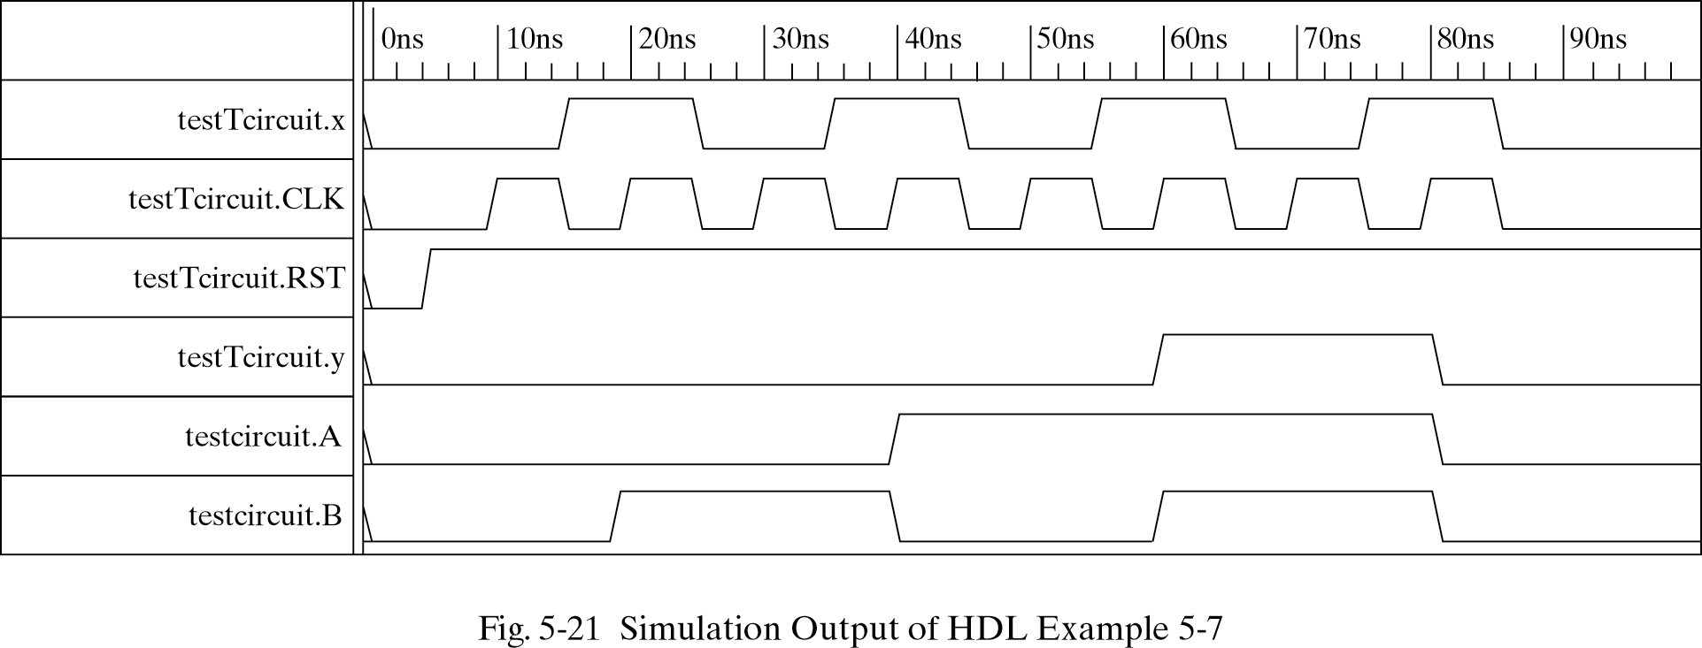
Waveforms

